Slide 1
CS50 Final Section
Ethics, Final Project, and Future Steps
Albert Zhu

Slide 2
Ethics

Slide 3
Ethics Intro Video
https://video.cs50.io/BB1dHgh9m_M?start=1

Slide 4
Ethics Discussion
Twitter and Fake News as a Group
Room 1: YouTube’s Adpocalypse
Room 2: Twitter’s Nudges
Room 3: Facebook and Voting Information

Slide 5
Ethics Lab (if we have time)
https://cs50.harvard.edu/college/2020/fall/labs/10/

Slide 6
Ethics Outro Video
https://video.cs50.io/NqMoLYVOFQQ?start=3

Slide 7
Final Project

Slide 8
Final Project Options
Besides Web Development using Flask, HTML, CSS, and JavaScript, you can do:
Android App
iOS App
Chrome Extension
Firefox Add-On
Game
Windows App
macOS App
Linux App
Raspberry Pi App
Arduino App
Hardware
Augmented Reality/Virtual Reality
Artificial Intelligence/Machine Learning

Slide 9
Final Project Tips
Start early
Start from the basics
Then build up if you have time
Budget time well: Each person contribute ~1 PSET worth of work
E.g. if you are working alone, spend at least 15 hrs on your project
Focus on overall functionality and appearance, don’t stress over small details
Use existing code, don’t reinvent the wheel:
Nice resource: https://codepen.io/
Good for getting pieces of HTML, CSS, and JS code

Slide 10
Final Project Tips
Start from the basics.
Then build up if you have time.

Slide 11
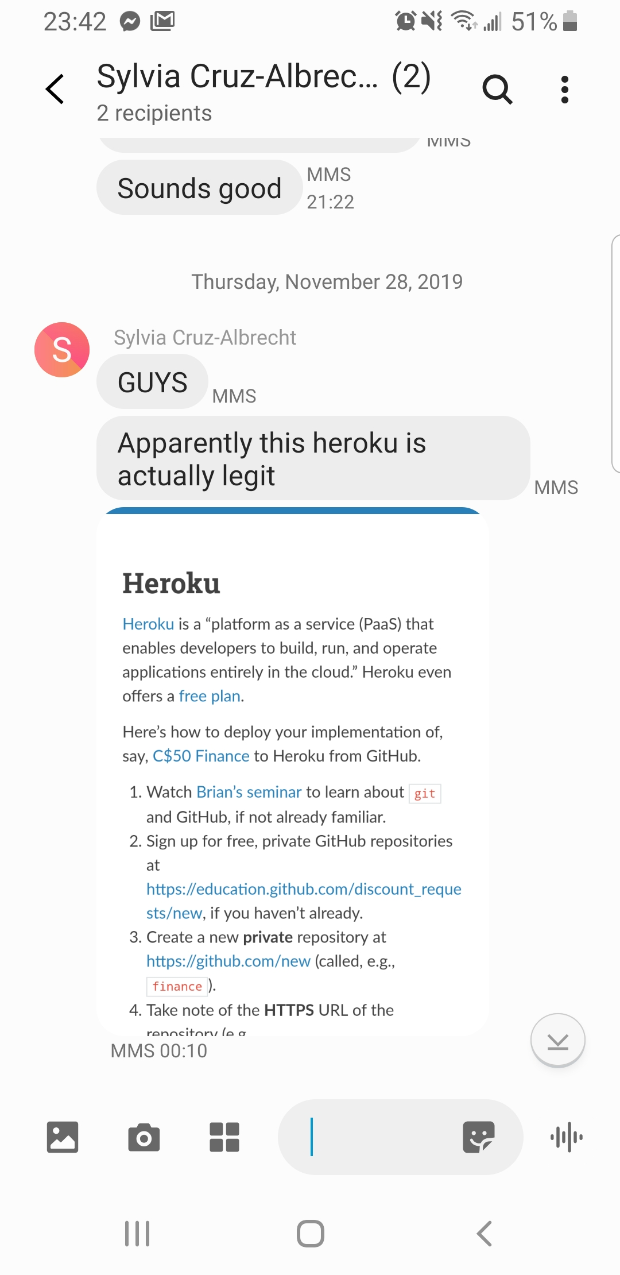
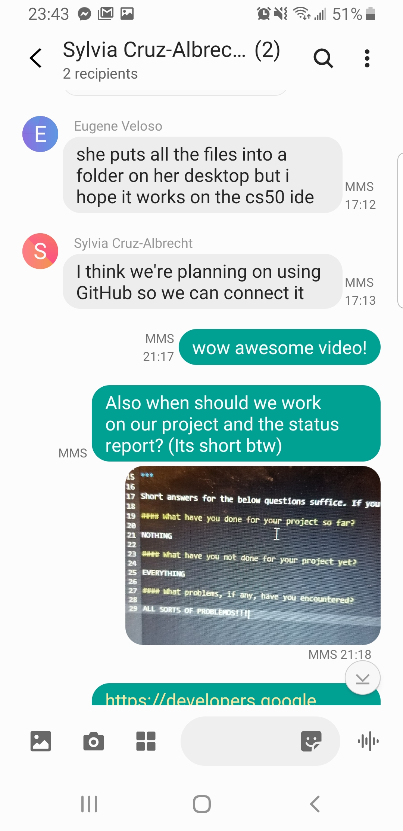
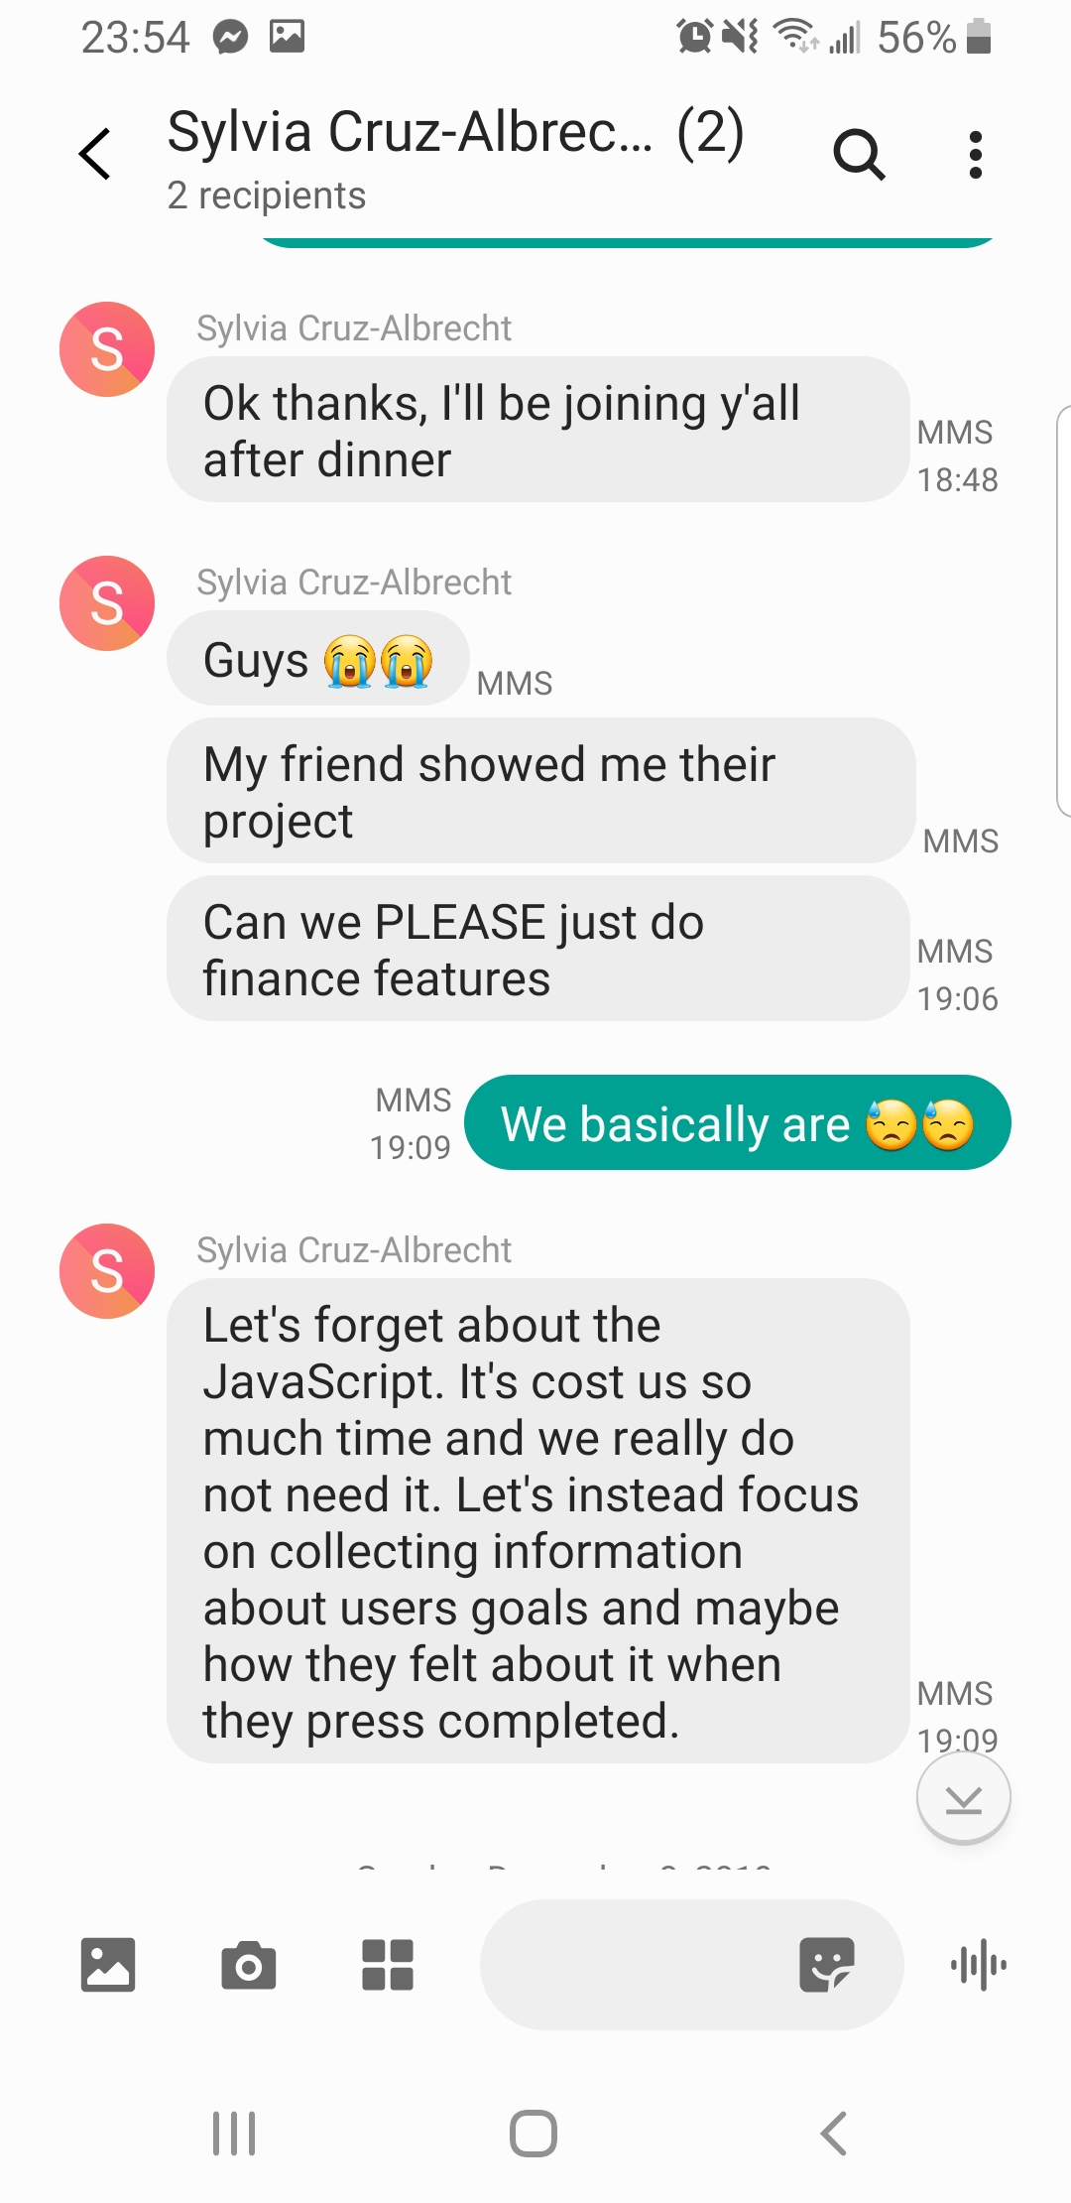
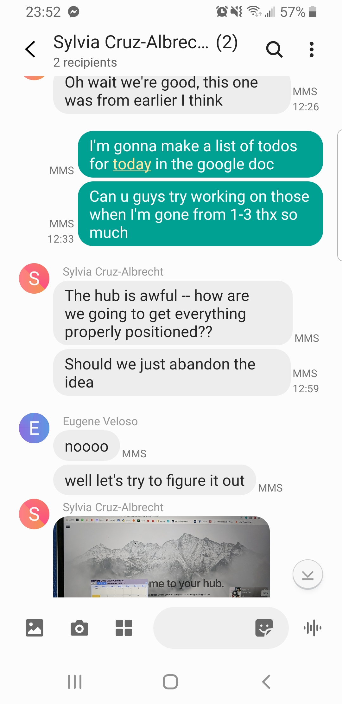
Final Project Tips
Don’t be like this!
How it started
How it’s going

Slide 12
Future Steps

Slide 13
CS Classes after CS50: For Concentrators
Freshman spring:
CS51: Abstraction & Design in Computation (common)
CS20: Discrete Math for CS (somewhat common)
CS124: Data Structures and Algorithms (uncommon)
Sophomore Fall:
CS121: Intro to Theoretical CS (somewhat common)
CS61: System Programming & Machine Organization (somewhat common)
Sophomore Spring:
CS124: Data Structures and Algorithms (common)
Stat110 recommended at some point. But you aren’t limited to these!

Slide 14
CS Classes after CS50: For Concentrators
CS13x and CS23x series: Economics and CS
CS14x and CS24x series: Computer Networks
CS15x and CS25x series: Programming Languages
CS16x and CS26x series: Systems
CS17x and CS27x series: Computer Graphics and Visualization
CS18x and CS28x series: Machine Learning and AI

Slide 15
CS Classes after CS50: Secondaries
4 courses
Commonly include: CS50, CS51, CS61, and a higher level CS course

Slide 16
CS Outside of Classes: Research
Somewhat hard to get into without theoretical CS background or background in another area, but still possible!
Programs:
PRISE (summer)
HCRP (Fall, spring, and summer)
Cold-emailing professors
For more info on research in general, check out Harvard URAF’s website

Slide 17



CS Outside of Classes: Clubs and EC’s
And probably many others!

Slide 18
Thank You!

